Slide 1

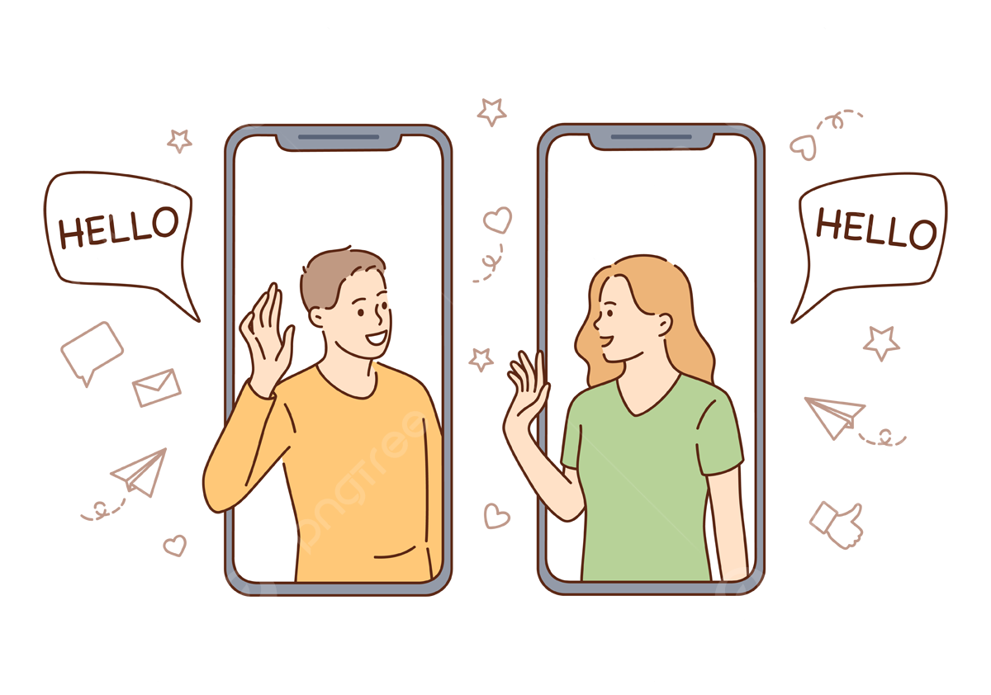



CHAT APPLICATION
By- Priya Kushawaha
Sudarshan Kapali
Suyog Bantawa Rai

Slide 2

Table of Contents
Introduction
Problem Statement
System Flow
Use Case
Objectives
System Methodology
Future Scope
Conclusion

Slide 3


Introduction
Our project is based on “Chat application” where users can use this project to chat between their friends and family members. A chat application is like a digital talking tool that lets you send messages to your friends and family instantly, almost like having a conversation in real life, but on your computer.
In this project, we dive into the development of a chat application that aims to streamline and enhance your digital communication experience. Whether you're connecting with friends, family, or colleagues, our chat application provides a user-friendly and adaptable platform for instant messaging.

Slide 4

Problem Statement
Fragmented User Experience
Privacy and Security Concerns
Limited Feature Sets
Innovation and Adaptation
Competition and User Retention

Slide 5
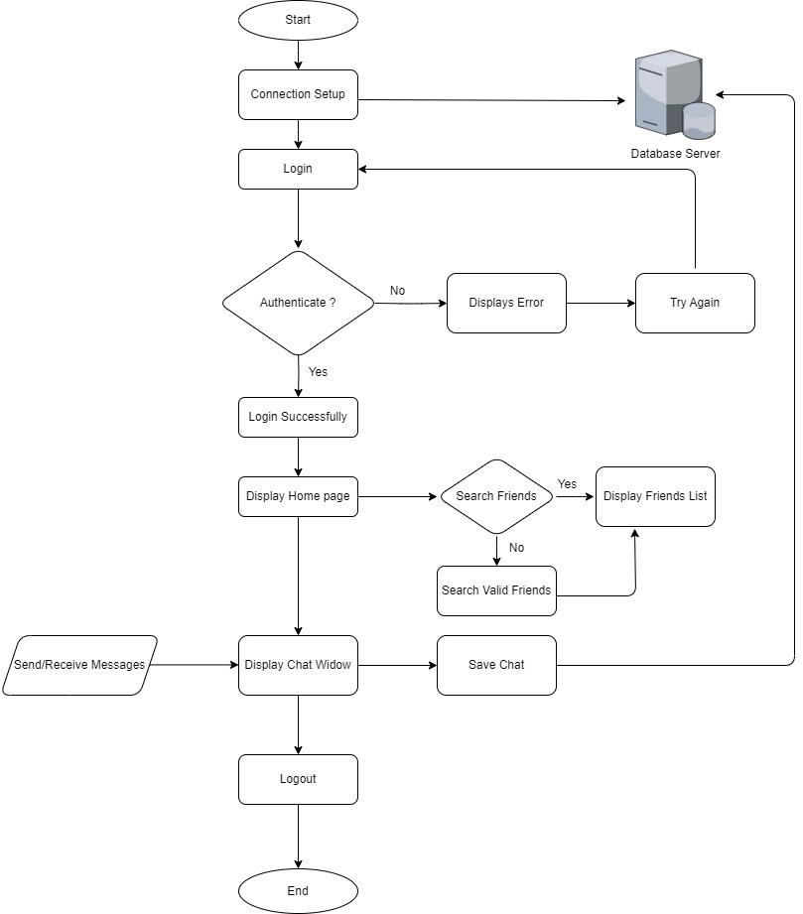
System Flow

Slide 6
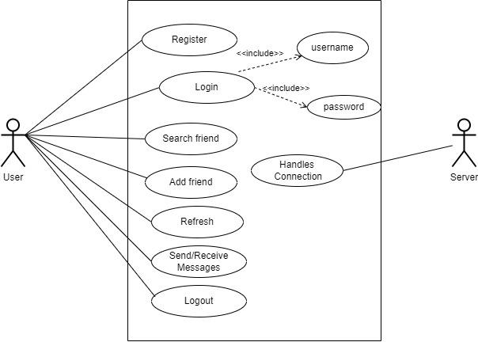
Use Case

Slide 7
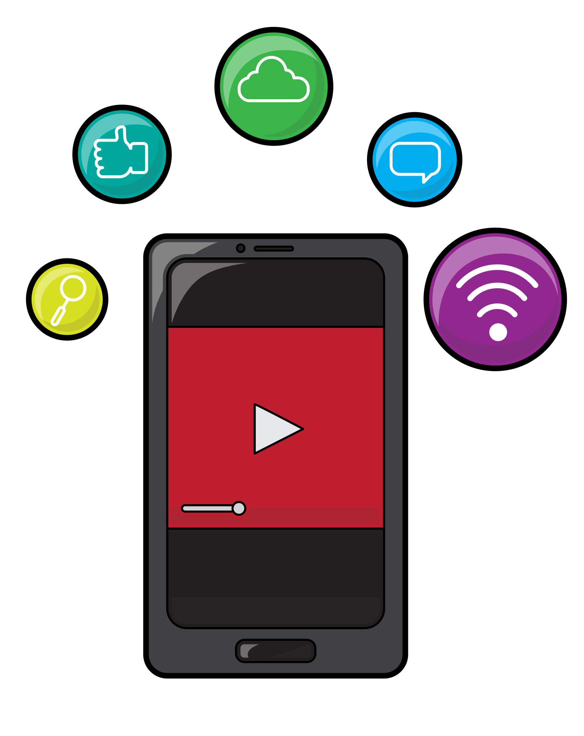
Objectives
Feature-rich Communication
User-Centric Design
Privacy and Security
Scalability and Cross-form Compatibility
Innovation and Adaptability

Slide 8

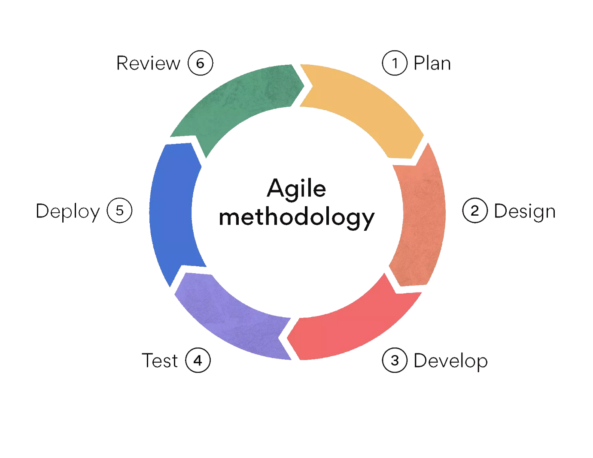
System Methodology

Slide 9

Future Scope
File Transfer
Voice Call
Video Call
Emojis and Stickers
Enhanced Privacy and Security

Slide 10
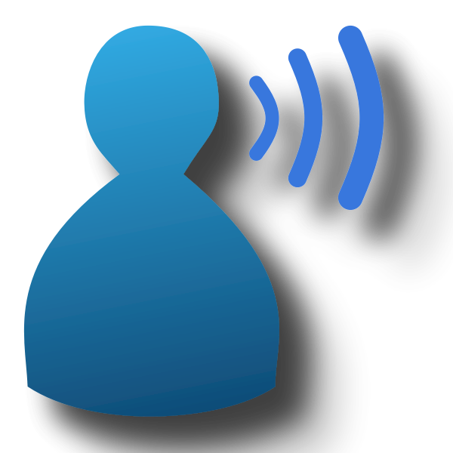
Conclusion
In conclusion, our chat application is more than just a platform for communication; it's a bridge that connects people across the digital landscape. We've tackled the challenges of fragmented user experiences, privacy concerns, and limited features head-on, providing a solution that's intuitive, innovative, and secure.
We extend our heartfelt gratitude to you for your time and attention.

Slide 11


